Slide 1

DR. D. Y. PATIL INSTITUTE OF TECHNOLOGY, Pimpri, Pune Department of Artificial Intelligence & Data Science
Academic Year: 2025-2026
A Project Presentation for the Partial fulfillment of the requirement of Degree of Bachelor in Artificial Intelligence and Data Science
“AI for Sustainable Urban Drainage System for Effective Waterlogging Prediction and Management”
Project Group Member Details
Sr. No | Exam Seat No | Name of Student
1 | B400240944 | Tushar Chavhan
2 | B400240977 | Sakshi Ingale
3 | B400240953 | Vrushali Dhage
4 | B400240969 | Snehal Godage
Project Guide Name :
Prof. Shubhangi Bhawari

Slide 2
Table of Contents
1
Introduction
2
Literature Survey
3
Research Gaps from Literature review

Slide 3
Table of Contents
4
Problem Statement
5
Objectives of Project
6
Scope of Project

Slide 4
Table of Contents
7
Methodology & System Architecture
8
Implementation of Project
9
Result and Evaluation

Slide 5
Table of Contents
10
Challenges Faced
11
Conclusion
12
Future work

Slide 6
Table of Contents
13
References
14
Published Papers/ Patents
Annexure if any

Slide 7
Introduction
Urban flooding has become one of the major challenges in rapidly growing smart cities like Pimpri-Chinchwad. During heavy rainfall, drainage systems often become overloaded, resulting in waterlogging, traffic congestion, property damage, and risks to public safety.
Currently, PCMC mainly relies on manual inspections and citizen complaints, which are reactive and time-consuming. There is no centralized intelligent system capable of continuously monitoring drainage conditions and predicting flood risks before they occur.
To address this issue, we developed AquaShield AI, an AI-based waterlogging prediction and drainage monitoring system that combines IoT, Machine Learning, GIS mapping, and real-time alerts.

Slide 8
Literature Survey
Reference | Authors & Year | Focus of Study | Methods / Techniques Used | Key Findings / Contributions | Limitations Noted
[1] | Misra et al., 2022 | AI-based smart drainage system | AI models + basic drainage automation | Improves blockage detection and basic flood prediction | Limited real-time integration; not multi-source
[2] | Dabas et al., — | Smart drainage for flood prevention | IoT + simple monitoring tools | Helps prevent flooding using automated checks | Lacks advanced AI and GIS integration
[3] | Saddiqi et al., 2023 | AI for managing sewer overflows | ML + hydrological modeling | Better overflow management using combined AI-hydraulic approach | High computational cost; slower for real-time use
[4] | Boughandjioua et al., 2023 | AI-based decision support for drainage | Review of AI methods | Provides overview of AI techniques for drainage systems | Not focused on real-time systems

Slide 9
Research Gaps from Literature review
Existing systems use single data sources only (e.g., weather data or sensors).
Lack of full integration of AI + IoT + GIS.
Limited scalability for large cities.
Inconsistent data and no standard communication protocols.
No centralized dashboards, predictive alerts, GIS visualization, continuous monitoring.

Slide 10
Problem Statement
Urban areas are facing serious waterlogging problems because of rapid urbanization, old drainage systems, and unpredictable rainfall.
Existing drainage systems are not smart or real-time — they rely on single data sources and cannot predict floods quickly or accurately.
There is a need for an AI-based system that can combine data from IoT sensors, GIS maps, and weather stations to predict, prevent, and manage urban flooding effectively.

Slide 11
Objectives
To develop an AI-based framework for predicting and managing urban waterlogging.
To predict possible waterlogging using AI models like LSTM.
To support smart city planning through dashboards, alerts, and automated drainage control.
To improve sustainability and reduce flood damage.
Monitor drainage conditions in real time.
Send instant alerts and visualize all locations on GIS map.

Slide 12
Scope of Project
1. Covers Urban Drainage Prediction and Management The project focuses on accurately predicting waterlogging in urban areas and helping manage drainage systems more efficiently through data-driven insights.
2. Uses IoT, GIS, and AI Integration It combines real-time IoT sensor readings, GIS-based drainage maps, and advanced AI models to create a smart and reliable flood prediction system.
3. Provides Early Warnings and Decision Support for City Authorities The system generates timely alerts, risk maps, and actionable recommendations, enabling authorities to take preventive measures before waterlogging occurs.
4. Can Be Extended to Smart Cities for Flood Management and Environmental Planning The framework is scalable and adaptable, making it suitable for broader smart city applications including flood management and long-term environmental planning.

Slide 13
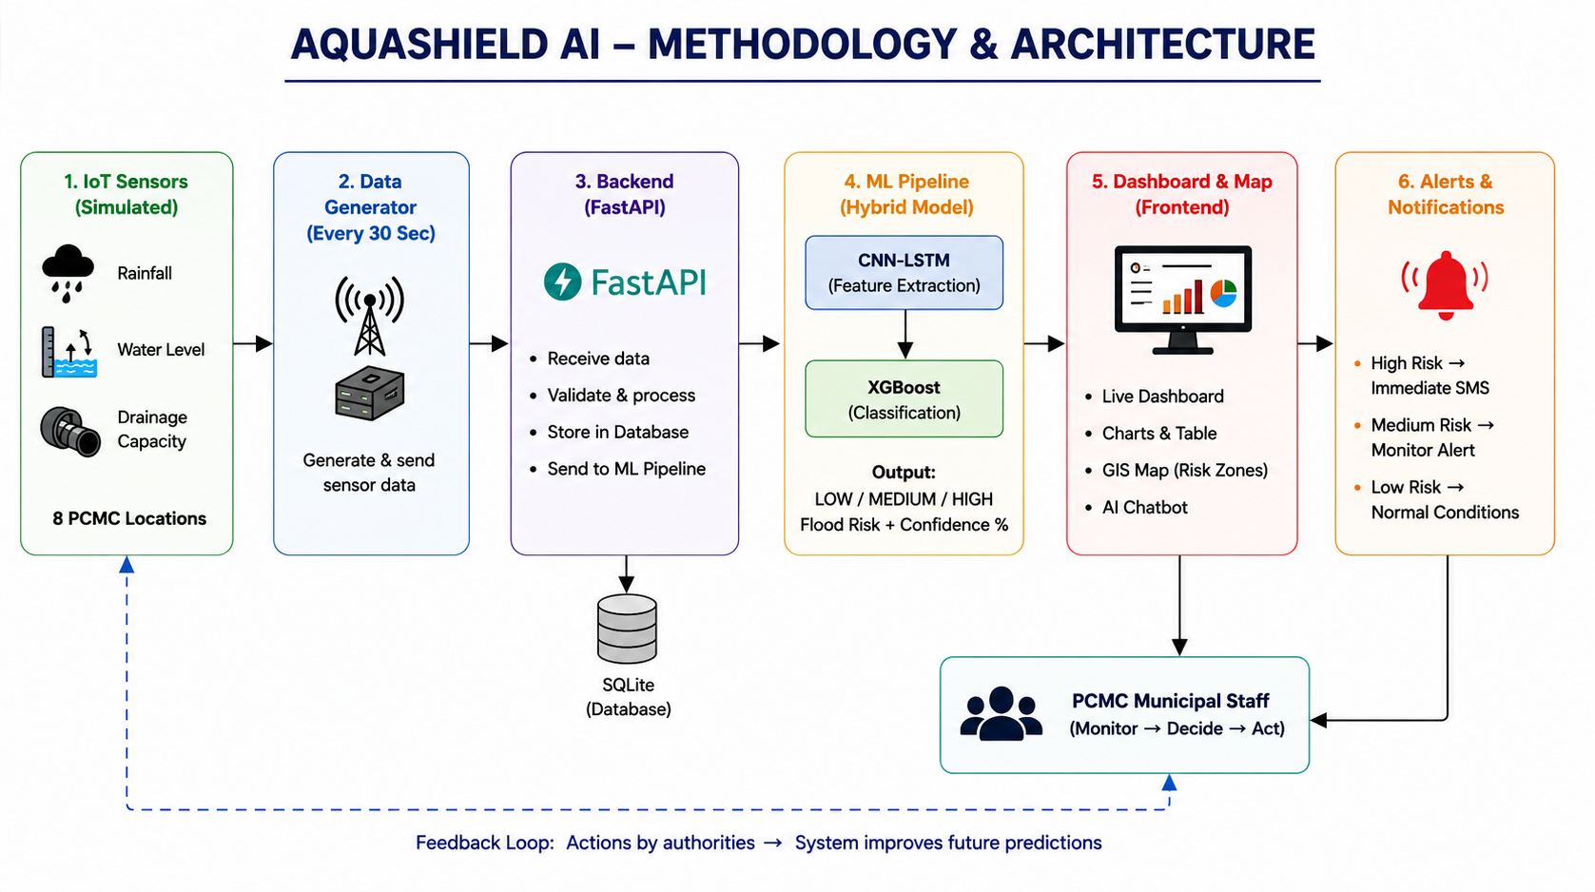
Methodology & System Architecture

Slide 14
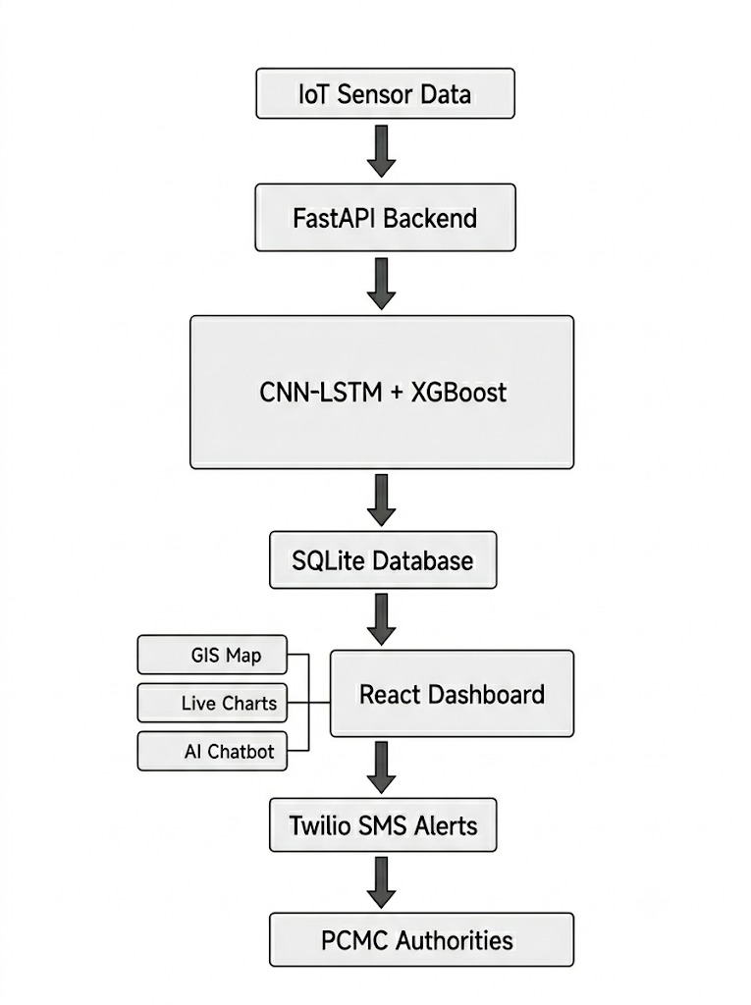
Implementation
Data Generation ↓ Data Processing ↓ AI/ML Prediction ↓ Backend (FastAPI) ↓ Database (SQLite) ↓ Frontend Dashboard ↓ Alerts & GIS Map

Slide 15
Result and Evaluation
Results
Live dashboard updates every 30 seconds.
Real-time GIS map displays flood risk locations.
AI chatbot answers user queries instantly.
SMS alerts are sent automatically during high-risk situations.
Dashboard provides charts and analytics for decision-making.
Performance
Prediction Accuracy: Approximately 95%
Locations Covered: 8
Update Interval: 30 Seconds
Real-Time WebSocket Communication
Compared to traditional manual monitoring, AquaShield AI provides faster and more accurate flood prediction.

Slide 16
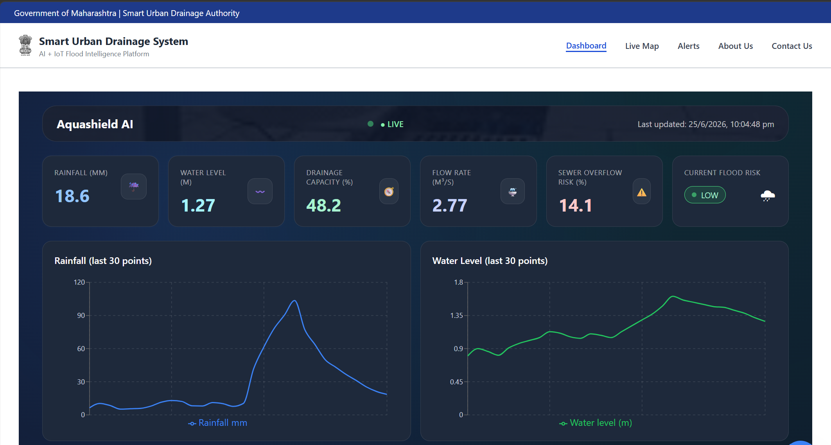
Results

Slide 17
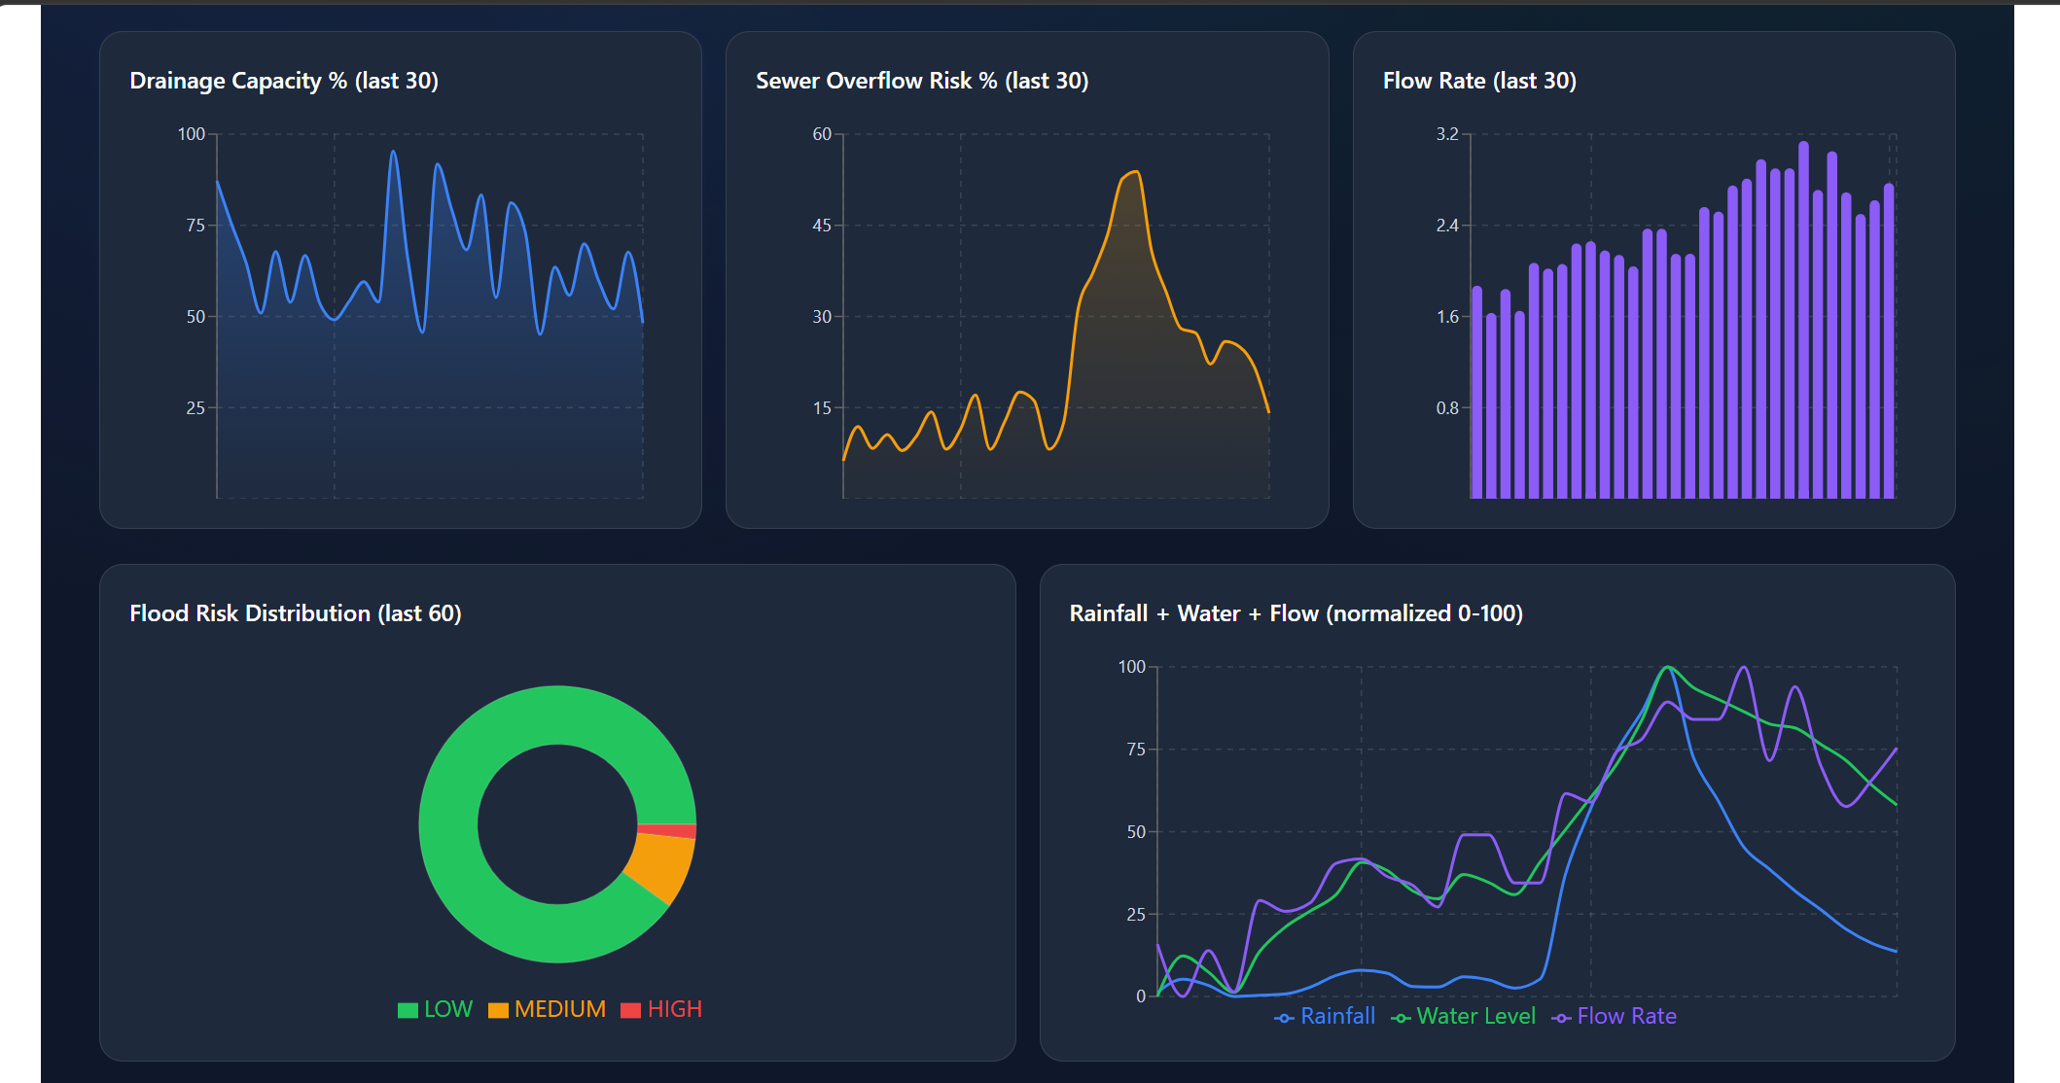
Results

Slide 18
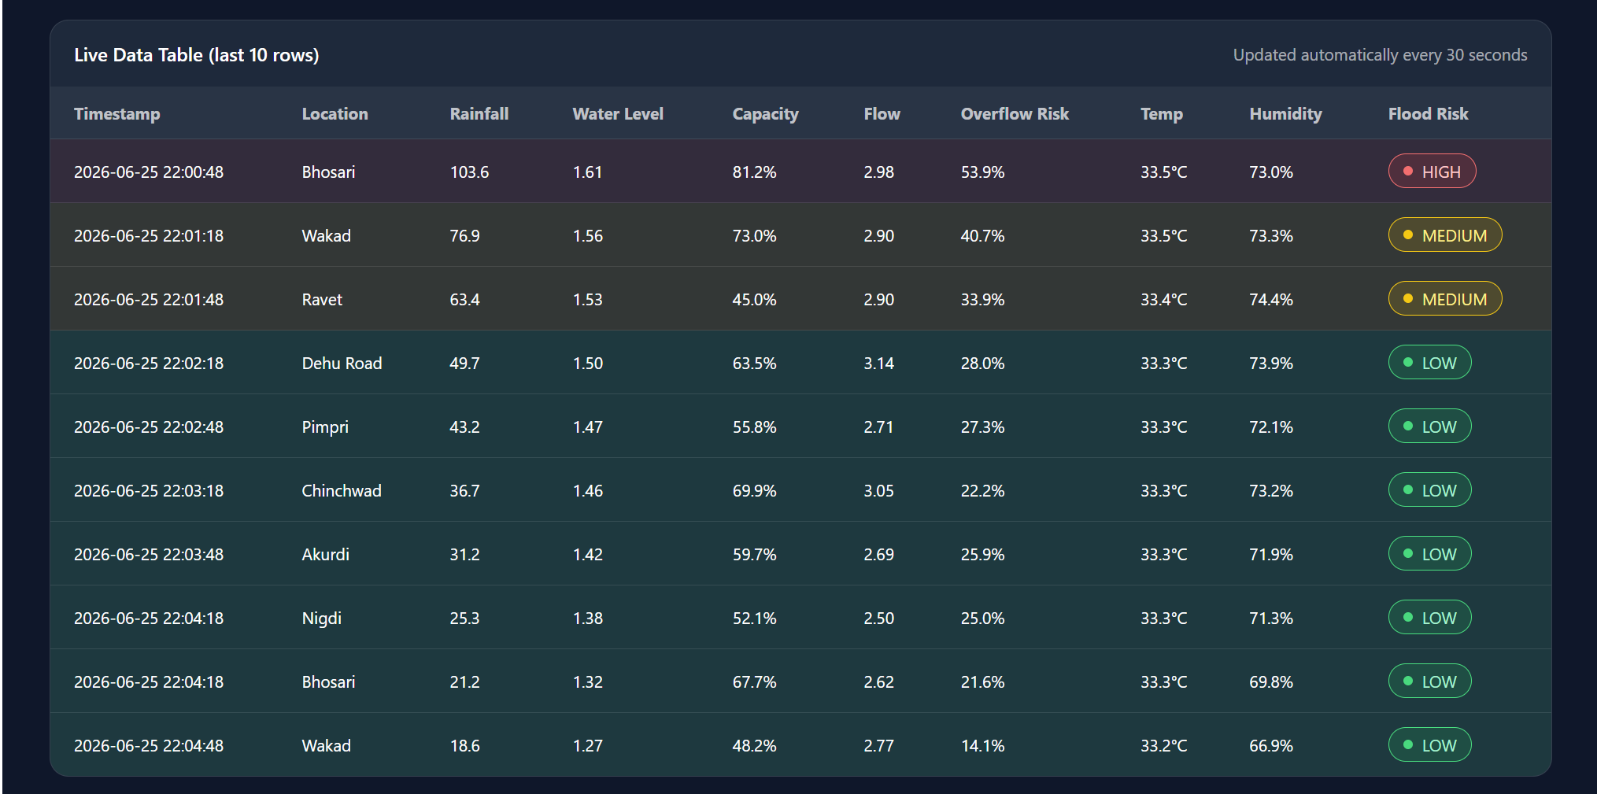
Results

Slide 19
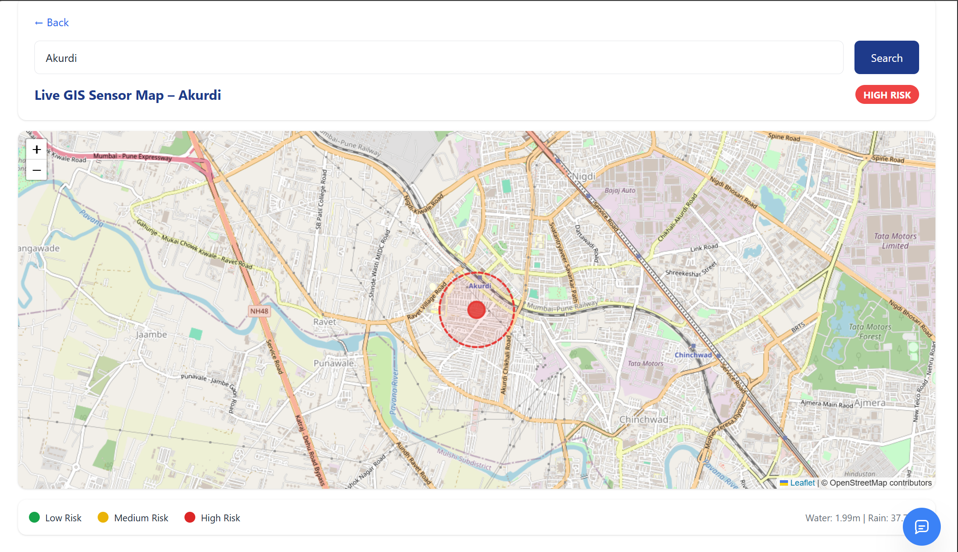
Results

Slide 20
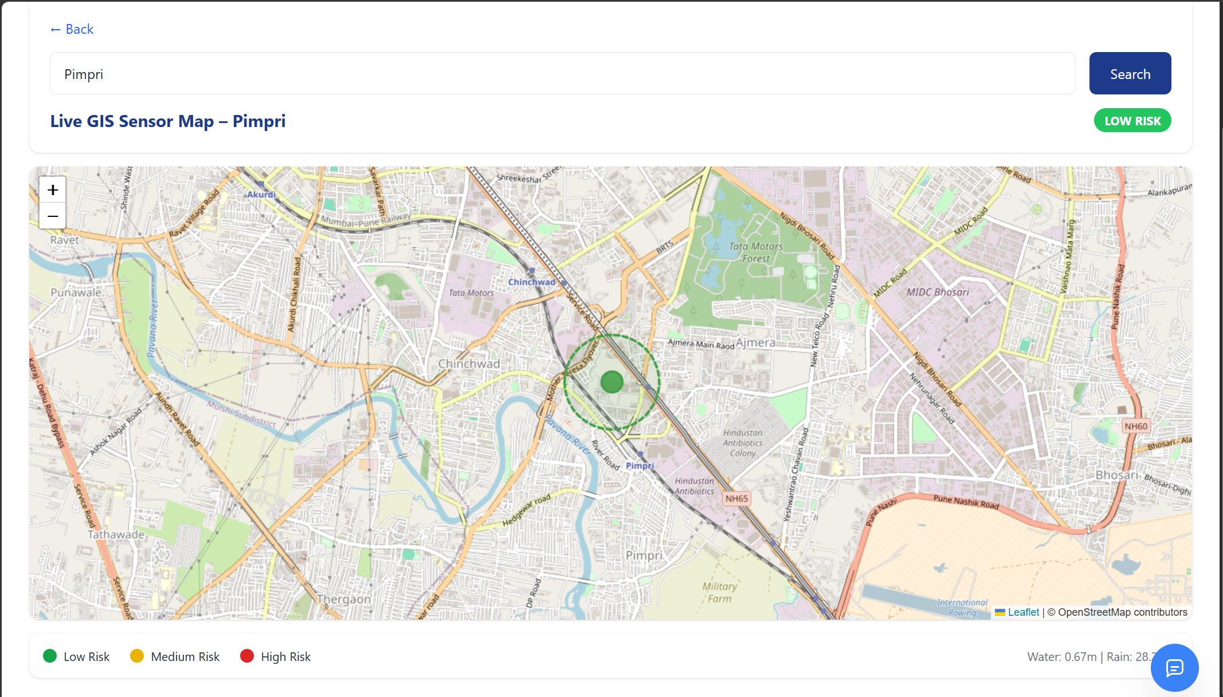
Results

Slide 21
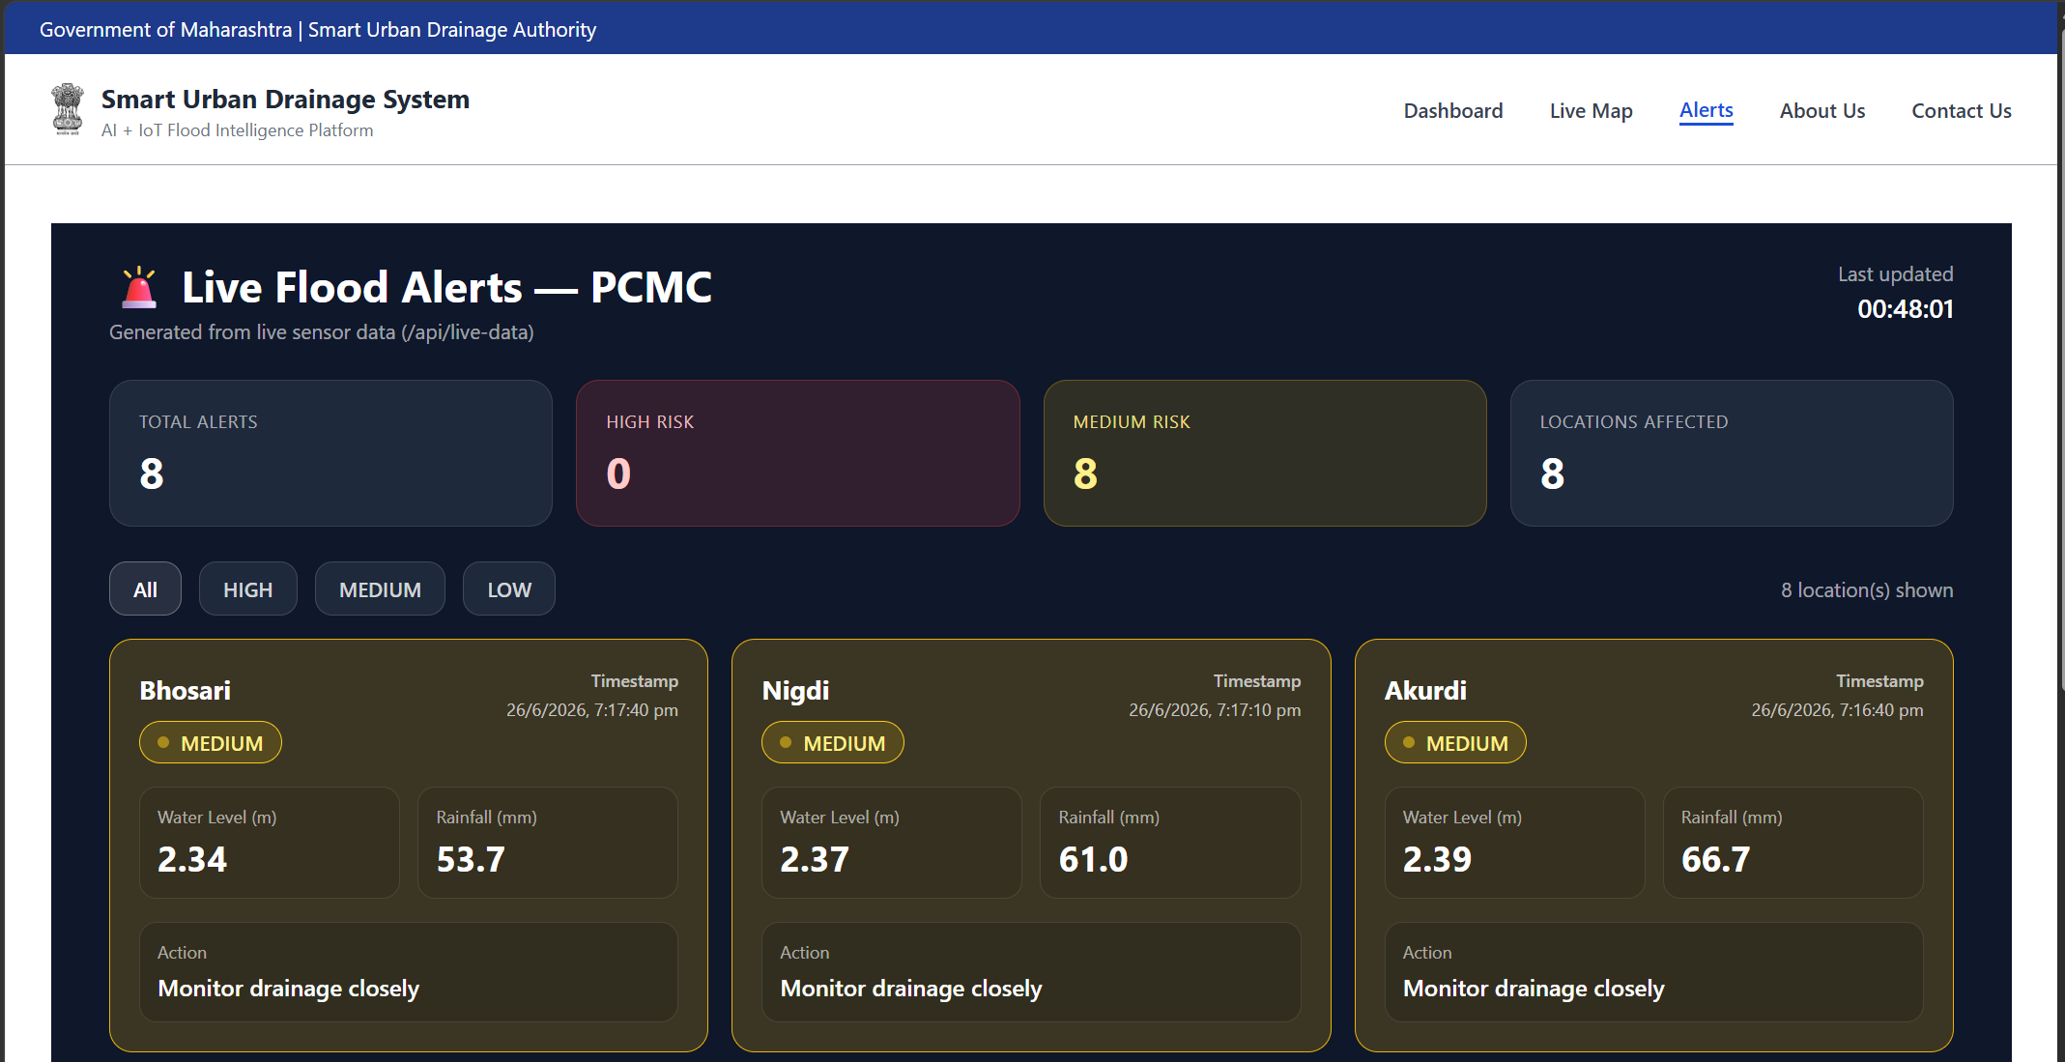
Results

Slide 22
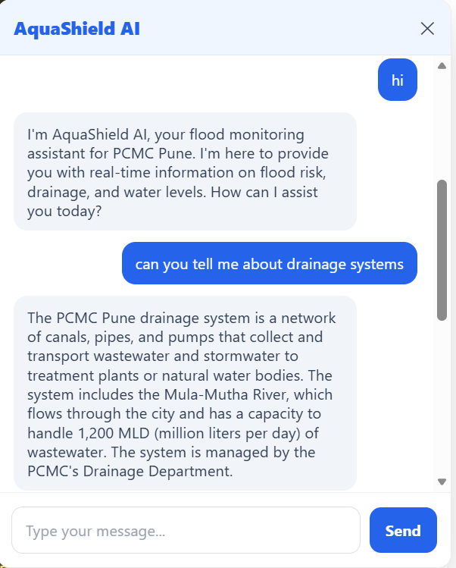
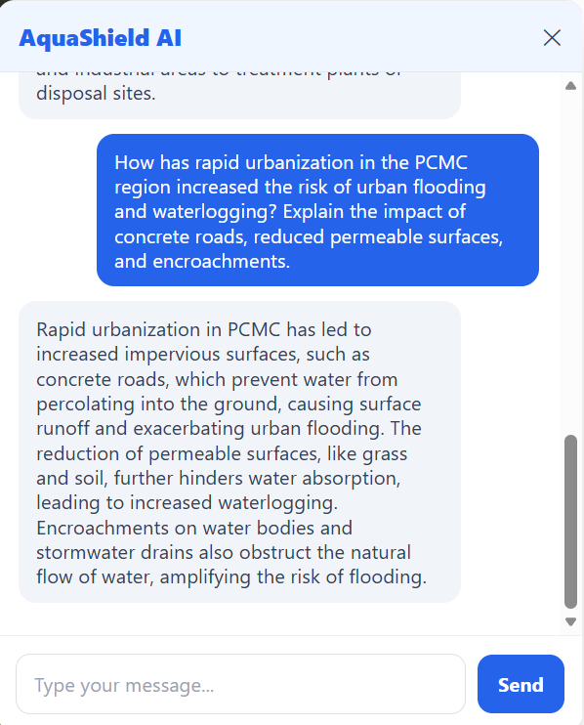
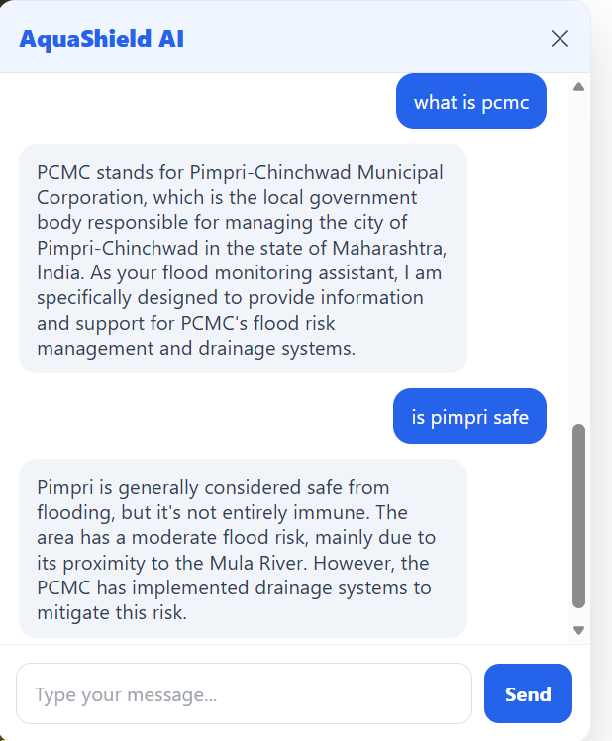
Results

Slide 23
Challenges Faced
Collecting real-world drainage datasets. Simulating realistic IoT sensor values.
Training and integrating the hybrid AI model. Managing WebSocket communication for live updates.
Integrating frontend, backend, AI, chatbot, GIS, and alerts into one platform.
Optimizing dashboard performance for real-time visualization.

Slide 24
Conclusion
Successfully demonstrates how Artificial Intelligence can improve urban drainage monitoring and flood management.
The system provides:
Continuous monitoring of drainage conditions.
Accurate flood risk prediction.
Real-time dashboard and GIS visualization.
Automated SMS alerts.
AI-powered decision support for municipal authorities.
It helps authorities take preventive actions, reducing waterlogging damage and improving public safety.

Slide 25
Future Work
Deploying real IoT sensors across the city
Integrating weather forecast APIs. .
Developing Android and iOS mobile applications.
Using CCTV cameras and computer vision for flood detection
Implementing drone-based monitoring.
Creating a Digital Twin of the drainage network.
Expanding the system to other smart cities across India.

Slide 26
References
[1] D. Misra, G. Das, and D. Das, “Artificial intelligent based smart drainage system,” 2022, preprint available at Research Square. [Online]. Available: https://doi.org/10.21203/rs.3.rs-1338435/v1
[2] R. Dabas, T. Imam, F. Safwat, S. Rizwan, and K. Alam, “Smart drainage system for urban flood prevention.”
[3] M. M. Saddiqi, W. Zhao, S. Cotterill, and R. K. Dereli, “Smart management of combined sewer overflows: From an ancient technology to artificial intelligence,” Wiley Interdisciplinary Reviews: Water, vol. 10, no. 3, p. e1635, 2023. [Online]. Available: https://doi.org/10. 1002/wat2.1635
[4] S. Boughandjioua, F. Laouacheria, and N. Azizi, “Integrating artificial intelligence for urban drainage systems aided decision: State of the art,” International Journal of Artificial Intelligence: Theory and Applications, vol. 2, no. 2, pp. 1–9, 2023. [Online]. Available: https://int-j-aita.univ-annaba.dz/wp-content/themes/ cbusiness-investment/view/vol2iss2/vol2iss2-1.pdf

Slide 27
References
[5] D. P. Selvam, G. G. Reddy, and N. M. Kumar, “Designing a smart and safe drainage system using artificial intelligence,” International Journal of Engineering Research and Technology (IJERT), vol. 9, pp. 497–500, 2020. [Online]. Available: https://www.ijert.org/research/ designing-a-smart-and-safe-drainage-system-using-artificial-intelligence-IJERTV9IS050307. pdf
[6] K. Haripriya, S. S. Hammed, C. Preethi, S. Pavalarajan, R. Padmakumar, and M. M. Surya, “Automated drainage management system: Ai and iot-based blockage detection for smarter cities,” in 2025 7th International Conference on Inventive Material Science and Applications (ICIMA). IEEE, 2025, pp. 998–1004. [Online]. Available: https://doi.org/10.1109/ICIMA64861.2025.11073840
[7] S. H. Kwon and J. H. Kim, “Machine learning and urban drainage systems: State-of-the-art review,” Water, vol. 13, no. 24, p. 3545, 2021. [Online]. Available: https://doi.org/10.3390/w13243545
[8] Y. Liu, Y. Liu, J. Zheng, F. Chai, and H. Ren, “Intelligent prediction method for waterlogging risk based on ai and numerical model,” Water, vol. 14, no. 15, p. 2282, 2022. [Online]. Available: https://doi.org/10.3390/w14152282

Slide 28
References
[9] R. Sekita, T. Watanabe, T. Yoshizawa, and K. Nakanishi, “Reliability improvement of rainwater-drainage system using iot and ai,” in 2024 Annual Reliability and Maintainability Symposium (RAMS). IEEE, 2024, pp. 1–6. [Online]. Available: https://doi.org/10.1109/ RAMS51492.2024.10457666
[10] P. S. Thanigaivelu, A. Sairam, P. Vijayan, A. S. Kumar, N. Mohankumar, and T. R. GaneshBabu, “Revolutionizing urban drainage: A smart iot approach to stormwater management using adaboosting algorithm,” in 2024 International Conference on Advances in Modern Age Technologies for Health and Engineering Science (AMATHE). IEEE, 2024, pp. 1–6. [Online]. Available: https://doi.org/10.1109/AMATHE61652.2024.10582217
[11] S. Veerappan, “Edge-enabled smart storm water drainage systems: A real-time analytics framework for urban flood management,” Journal of Smart Infrastructure and Environmental Sustainability, vol. 1, no. 1, pp. 52–59, 2024. [Online]. Available: https://doi.org/10.17051/JSIES/ 01.01.06
[12] U. K. Sharma and A. Maurya, “Ai for predictive urban water drainage systems,” International Journal of Progressive Research in Engineering Management and Science, vol. 4, no. 12, pp. 763–767, 2024. [Online]. Available: https://www.doi.org/10.58257/IJPREMS37638

Slide 29
Published Papers/ Patents
Paper Title: A Smart Computing Framework for AI-Driven Urban Drainage and Waterlogging Prediction
Conference: 2nd International Conference on Electronics, Computing, Communication and Networking Automation Technologies 2026
Paper ID: 3949
Authors: Tushar Chavhan, Sakshi Ingale, Snehal Godage, Vrushali Dhage
Status: Under Review

Slide 30
Thank you

